Slide 1
Jacqueline Mansourian-Robert
Mother of Christophe, 29 year old .
PhD in Educational Sciences (Paris V, La Sorbonne)
Master of prevention, promotion and education in Public Health (University of Tours)
M.B.A. (USA)
Autism-France representative to the board of Autism-Europe
Member of the board of the Federation of Regional Actors in Health Promotion (FRAPS)
Member of AECSE
Member of scientific committee of Autisme-France
Actually, collaboration with University of Tours about definition of indicators of the quality of life in people with ASD (Laboratory of Public Health)

Slide 2
DIALOGUE AUTISME
Regional Association
Affiliated to AUTISME FRANCE
Council Administrator of AUTISME-EUROPE
Founded in 1999 by parents of child, teenagers and adults with ASD, with or without associated disorders
Member of Regional Technical Committee for Autism and Regional Conference for Health and Autonomy

Slide 3
Purposes of Dialogue-Autisme
Promote information and assistance
to establish an individualized special education
to integrate people with ASD into society and to give them access to a decent life
training for staff and families (conferences, courses, publications, exhibitions, ...)

Slide 4
Purposes of Dialogue-Autisme
Develop research on ASD: collaboration with Dr Sylvain Briault, team leader, Laboratory of Molecular Immunology and Embryology, UMR6218 CNRS - University of Orléans, and chief of department of Genetic at CHR Orléans
Support for the project IndiaRose of two young researchers(University of Orleans): graphics tablet for people with autism (Award Imagine Cup 2011 (United States ) by Microsoft)
Defending the rights of people with ASD and fight against discrimination and violence they may suffer.

Slide 5
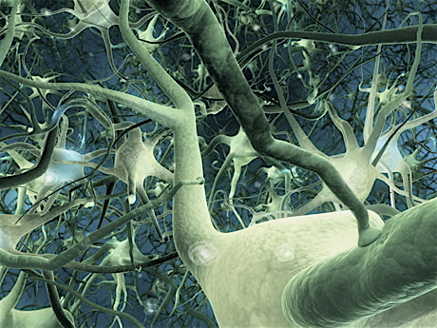
Autism, mental deficiency
and genetics
Laboratory of Molecular Immunology and Embryology
UMR6218 CNRS - University of Orléans –France
Team « Experimental and Molecular Genetics »
Sylvain BRIAULT – sbriault@cnrs-orleans.fr

Slide 6
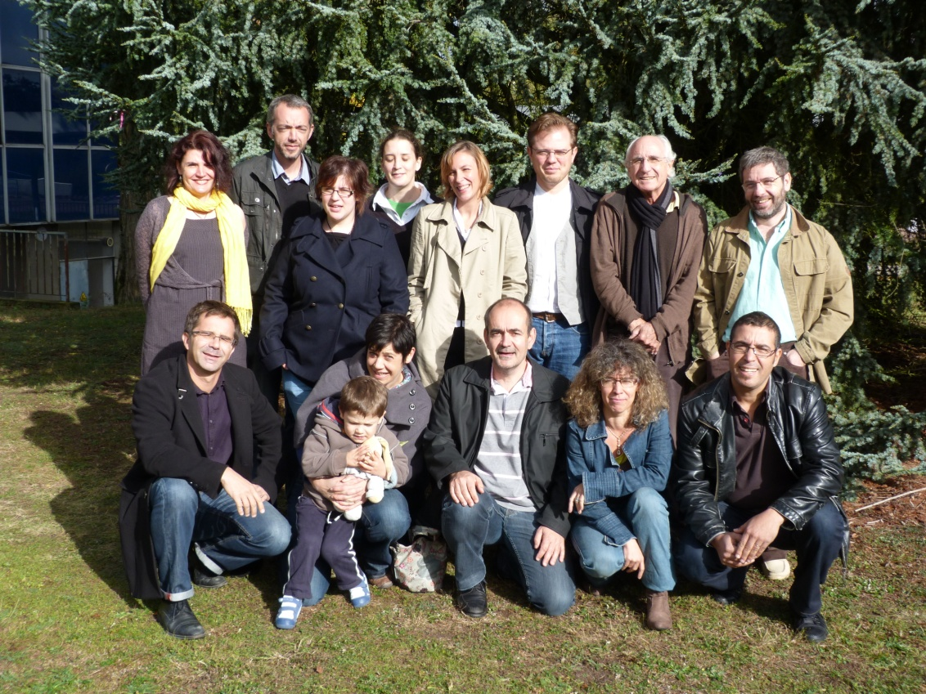
Laboratory of Molecular Immunology and Embryology -UMR 6218 CNRS - University of Orléans
Team “Experimental and Molecular Genetics“
http://transgenose.cnrs-orleans.fr/iem
sbriault@cnrs-orleans.fr
S Briault, MD, PhD,
B Laudier, MD,
J Pichon, Professor,
M Ardourel, Assistant Professor,
A Menuet, Assistant Professor,
S Mortaud, Assistant Professor,
C Montecot, Assistant Professor,
O Richard, Assistant Professor,
L Baala, PhD, Engineer,
M Fauconnier, PhD,
O Perche, PhD, postdoctoral fellow,
B Hebert, PhD Student,
M Marcos, Assistant Engineer.

Slide 7
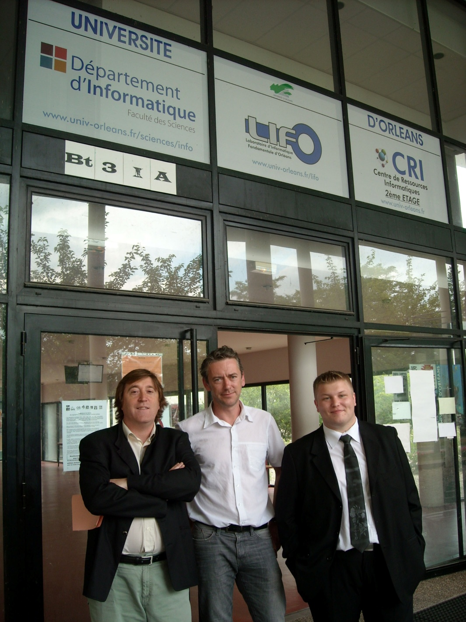
Anthony FROISSANT , student
Frédéric MOAL, director
José MARTINS, student

Slide 8
Achievements of Dialogue-Autisme
We created three institutions:
41 places for children and adolescents,
24 places for adults
We created a training center Dialogue-Autisme
We are participants in all regional authorities which can decide for ASD

Slide 9
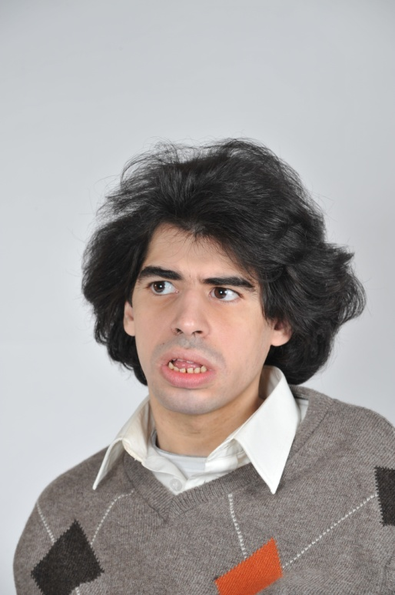
WHO IS CHRISTOPHE PILLAULT?
BORN 2 APRIL 1982

Slide 10
Christophe is born on 2 April 1982 (26 years before first World Autism Awareness Day!)
Christophe’s early development seemed quite normal.
But he has some of the common characteristics which are usually considered:
Unability to initiate or sustain a normal conversation, stereotypes, repetitive movements
Overly dependent on specific routines or rituals
Preoccupied with parts of objects.

Slide 11
He is an autistic person with associated handicaps.
His talent was discovered by his educator in his school.
He paints with his hands and his fingers.
First exhibition in 1993 in Paris: he was 13 years old

Slide 12
Christophe’s painting is a real autistic vision of our world, in which he tries to live, no matter how hard he tries.
With his paintings, he engages a very specific interaction.
He engages himself in conversation, by giving to his personnage prime focus.
He communicates his emotions and feelings.
Christophe, as well as a few another artists with ASD, can offer the opportunity to use their talents as a purpose to communicate with public and politicians.

Slide 13
My point is to explain that their quality of life depends also to the social roles that they can play in the society and the place which the actuel and future society will be able to offer them.
"Able autistic individuals can rise to eminent positions and perform with such outstanding success that one may even conclude that only such people are capable of certain achievements" (Asperger, 1944)
A "challenge to our capabilities"

Slide 14
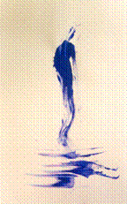
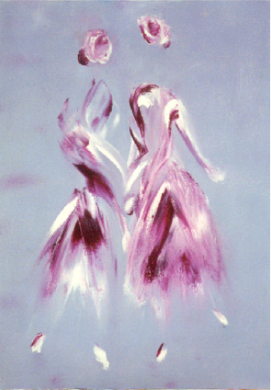
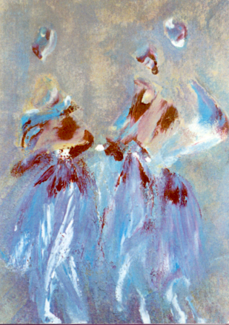
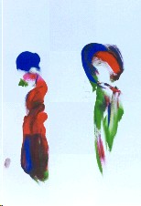
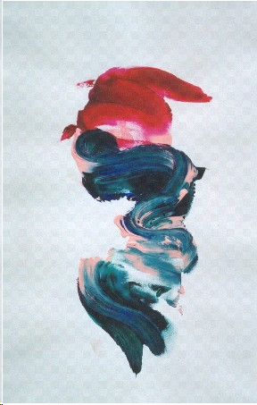
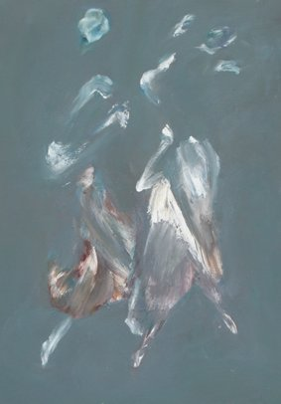
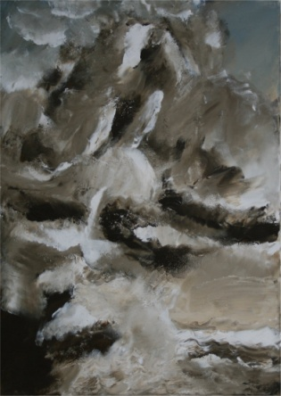
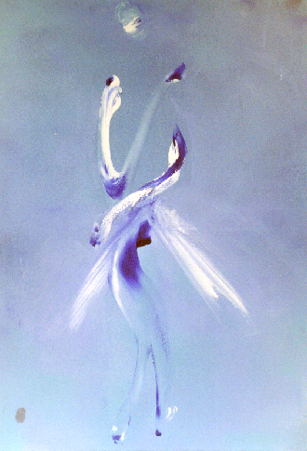
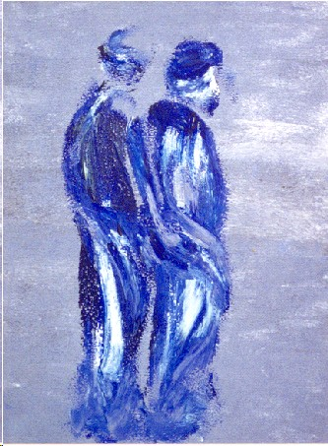
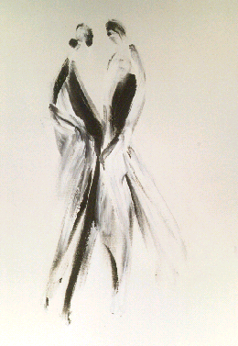
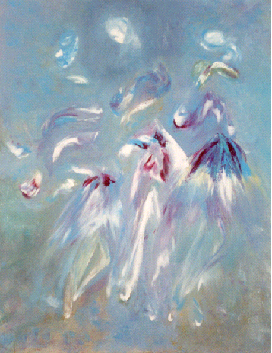
Christophe PILLAULT

Slide 15
WHO IS AUTISME-FRANCE?

Slide 16
An association of parents known as public utility
Approximately 9000 families
Over 125 member associations (partners and affiliates).
Autisme-France was born in 1989 from the observation that autistic people in France do not always have the right to a correct diagnosis and a decent support throughout their lives.

Slide 17
AUTISM FRANCE argues first for screening and early diagnosis consistent with international classifications.
AUTISM FRANCE wants to disseminate information on autism as widely as possible.
AUTISM FRANCE fights for the support throughout the life the person with autism.

Slide 18
AUTISME-FRANCE INITIATED A CULTURAL REVOLUTION IN ORDER TO SEPARATE AUTISM FROM PSYCHIATRIC INSTITUTION
AUTISME-FRANCE FIGHTS TO INSURE THE EDUCATIONAL AND PROFESSIONAL, SOCIAL INTEGRATION BY A WIDEST FINANCIAL SUPPORT.
THE POSITION OF PEOPLE WITH AUTISM OR OTHER ASD IS NOT IN PSYCHIATRIC HOSPITAL.

